Slide 1
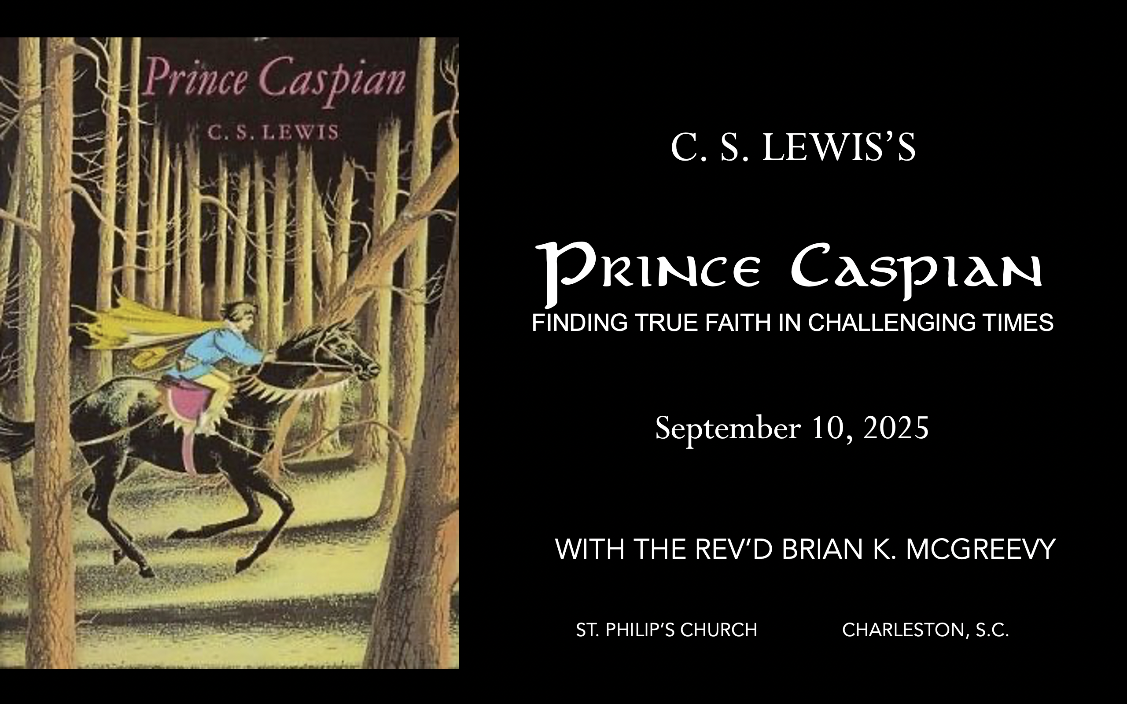


Slide 2
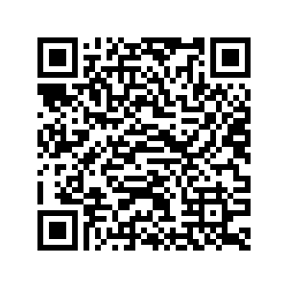
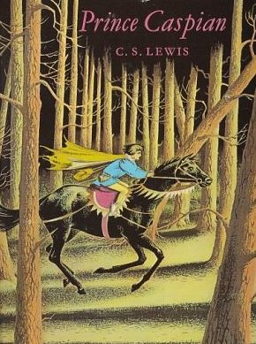
How to approach this class: How to approach this class:
--On the beach --Snorkeling --Scuba diving --Email list/QR code How to read this book: --Try reading aloud and slowly, looking for layers of meaning
--Look for themes/underline and highlight passages that resonate with you
What we’ll be doing:
--Setting the background and context
--Following the story chapter by chapter
--Drawing out principles for living with Joy and Purpose
--Looking at relevant Scripture

Slide 3
For you were once darkness, but now you are light in the Lord. Live as children of light (for the fruit of the light consists in all goodness, righteousness, and truth), and find out what pleases the Lord.
Have nothing to do with the fruitless deeds of darkness, but rather expose them. It is shameful even to mention what the disobedient do in secret. But everything exposed by the light becomes visible—and everything that is illuminated becomes a light. This is why it is said: “Wake up, sleeper, rise from the dead, and Christ will shine on you.” Be very careful, then, how you live— not as unwise but as wise, making the most of every opportunity because the days are evil.
Ephesians 5:8-15

Slide 4
Why Narnia matters SO much today Aggressively secular narrative pervading our culture—how to counter?
Which Story Can We Trust? Either
We are here by accident, meaningless products of a random process. We create our own identity and can only invent meaning and purpose in life and do our best to stay alive—even though there is no point to life. Sartre, Dawkins, Nietzsche, most schools OR
We are precious creatures made by and in the image of a loving God, who has created us for something special that we are asked to do. We have the privilege of being able to do good and experience purpose as we live by faith in Christ in His Kingdom. The witness of Scripture, the Church, and the saints
These two stories are totally incompatible. They can’t both be right: cognitive dissonance. So which do we trust? Other stories, like the Chronicles of Narnia, can help us here by highlighting dissonance or by creating a narrative we want to inhabit. So which do we trust? Is Jadis really the Queen of the realm of Queen Narnia? OR Is she the White Witch, a usurper in Narnia, which is really the realm of the mysterious great and noble lion, Aslan? Gradually, one story about Narnia emerges as supremely plausible, as each individual story turns out to be part of this greater narrative. This grand narrative of interlocking stories makes sense of the riddles the children see and experience and reveals the character of each narrative. These stories teach that Biblical truth and the wisdom of the world cannot both be True---we need to learn to think critically because we are surrounded by falsehood.
We each have our unique story. But our own story needs to be brought into connection with a grand narrative, a big story which gives our story a new importance and significance. Why? Because we realize that our story is framed by something greater which gives us value and purpose. Lewis’s remarkable achievement in Narnia is to allow his readers to inhabit this big story, to get inside it and feel what it is like to be part of it. --Rev. Dr. Alister McGrath, Holder of the Andreas Idreos Chair in Science and Religion, Oxford University (Ph.D. in Molecular Biophysics, Doctor of Divinity in Theology, and Ph.D. in Intellectual History, at Oxford)

Slide 5
Imagination: What Does It Mean to Inhabit a Story
“The shaping of our loves, desires, and imagination thus happens primarily
The Narnia stories are deeply grounded in the Biblical story and its four major scenes of Creation, Fall, Redemption, and New Creation. The White Witch, Miraz, and other evil characters in the Narnia stories are all engaged in the evil enchantment of encouraging a Disciplined Forgetting of Aslan, his Story, and the Deep Magic.
In The Chonicles of Narnia, Lewis wants to show us through Story, experienced through the eyes and experiences and emotions of children, the Truth and Beauty and Goodness of Creation, the horror of the Fall, the immense Love shown in redemption, and the Hope and Joy and Glory of the New Creation, even though it is not yet fully realized but where we see that “Aslan is on the move” (the theological concept of the Now and Not Yet).
Unseen Realities
For this light momentary affliction is preparing for us an eternal weight of glory beyond all comparison, as we look not to the things that are seen but to the things that are unseen. For the things that are seen are transient, but the things that are unseen are eternal.—2 Corinthians 4:17-18

Slide 6
Why Prince Caspian is especially relevant today
Imagine living in a land
--that had forgotten its history and substituted a revisionist narrative that said all evidences of the Divine were foolish myths,
--where individuals struggled to practice their faith while being surrounded by a sea of doubters and skeptics,
--where Evil seemed poised to triumph over Good, and
-- where even the strongest believers wondered sometimes whether they had been abandoned.
Welcome to the world of Prince Caspian, the next book of the Chronicles of Narnia after The Lion, the Witch, and the Wardrobe. C.S. Lewis wrote that this book concerns the “restoration of the true religion after a corruption.
We will be examining such themes as
--how disbelief and doubt creep into our lives,
--the effects of living under the wrong framework of reality,
--the importance of cultivating virtue and courage, and
--the priority of seeking the Kingdom of God with our whole heart.

Slide 7
Chapter 1: “The Island”
(Firing the imagination—what island? There was no island in the previous story. What could this mean?)
Peter, Susan, Edmund, and Lucy are together in a country train station returning back to boarding school when they feel tugged at and realize it’s Magic, so they hold hands and embrace the adventure
They find themselves landed in a thick and silent wood and Lucy immediately wonders if they are back in Narnia; Peter says they might be anywhere
They explore and make their way to a beautiful sandy beach on the sea, have a brief frolic, then realize they need to find water and food, so they set off to search for a stream
In their exploration they determine they are on an island, find a beautiful clear stream, and then in exploring the wood find an apple orchard and an ancient and very high wall
Themes
The call to Narnia/the Kingdom often comes when you do not expect it and aren’t looking for it
There is wisdom in being guided by “the books”
Being proactive, accepting the adventure, and exploring are needful
Keeping alive your capacity for Wonder is important in embracing the call

Slide 8
Peter, Susan, Edmund, and Lucy are together in a country train station returning back to boarding school when they feel tugged at and realize it’s Magic, so they hold hands and embrace the adventure
“They were, in fact, on their way back to school... The first part of the journey, when they were all together, always seemed to be part of the holidays; but now when they would be saying good-bye and going different ways so soon, everyone felt that the holidays were really over and everyone felt their term-time feelings beginning again, and they were all rather gloomy and no one could think of anything to say…It was an empty, sleepy, country station and there was hardly anyone on the platform except themselves. Suddenly Lucy gave a sharp little cry, like someone who has been stung by a wasp. "What's up, Lu?" said Edmund — and then suddenly broke off and made a noise like "Ow!" "What on earth—",began Peter…"I'm not touching you," said Susan. "Someone is pulling me…” Everyone noticed that all the others' faces had gone very white. "I felt just the same," said Edmund in a breathless voice. "As if I were being dragged along. A most frightful pulling-ugh! it's beginning again." "Me too," said Lucy. "Oh, I can't bear it." "Look sharp!" shouted Edmund. "All catch hands and keep together. This is Magic — I can tell by the feeling. Quick!" "Yes," said Susan. "Hold hands. Oh, I do wish it would stop-oh!"
They find themselves landed in a thick and silent wood and Lucy immediately wonders if they are back in Narnia; Peter says they might be anywhere
“Next moment the luggage, the seat, the platform, and the station had completely vanished. The four children, holding hands and panting, found themselves standing in a woody place — such a woody place that branches were sticking into them and there was hardly room to move. They all rubbed their eyes and took a deep breath. "Oh, Peter!" exclaimed Lucy. "Do you think we can possibly have got back to Narnia?" "It might be anywhere," said Peter. "I can't see a yard in all these trees. Let's try to get into the open — if there is any open."

Slide 9
They explore and make their way to a beautiful sandy beach on the sea, have a brief frolic, then realize they need to find water and food, so they set off to search for a stream
“…After a few steps they found themselves at the edge of the wood, looking down on a sandy beach. A few yards away a very calm sea was falling on the sand with such tiny ripples that it made hardly any sound. There was no land in sight and no clouds in the sky. The sun was about where it ought to be at ten o'clock in the morning, and the sea was a dazzling blue. They stood sniffing in the sea-smell. "By Jove!" said Peter. "This is good enough." Five minutes later everyone was barefooted and wading in the cool clear water. "This is better than being in a stuffy train on the way back to Latin and French and Algebra!" said Edmund. And then for quite a long time there was no more talking, only splashing and looking for shrimps and crabs. "All the same," said Susan presently, "I suppose we'll have to make some plans. We shall want something to eat before long.” Everyone else now felt thirsty, as one usually is after wading in salt water under a hot sun. "It's like being shipwrecked," remarked Edmund. "In the books they always find springs of clear, fresh water on the island. We'd better go and look for them." ""If there are streams they're bound to come down to the sea, and if we walk along the beach we're bound to come to them."
In their exploration they determine they are on an island, find a beautiful clear stream, and then in exploring the wood find an apple orchard and an ancient and very high wall
"I wonder, is that an island or do we join on to it presently?" said Lucy. "Don't know," said Peter and they all plodded on in silence. The shore that they were walking on drew nearer and nearer to the opposite shore, and as they came round each promontory the children expected to find the place where the two joined. But in this they were disappointed. They came to some rocks which they had to climb and from the top they could see a fairway ahead and — "Oh bother!" said Edmund, "it's no good. We shan't be able to get to those other woods at all. We're on an island!" It was true. At this point the channel between them and the opposite coast was only about thirty or forty yards wide; but they could now see that this was its narrowest place. After that, their own coast bent round to the right again and they could see open sea between it and the mainland. It was obvious that they had

Slide 10
already come much more than halfway round the island. "Look!" said Lucy suddenly. "What's that?" She pointed to a long, silvery, snake-like thing that lay across the beach. "A stream! A stream!" shouted the others, and, tired as they were, they lost no time in clattering down the rocks and racing to the fresh water. They knew that the stream would be better to drink farther up, away from the beach, so they went at once to the spot where it came out of the wood.
"Look here. We must explore the wood. Hermits and knights-errant and people like that always manage to live somehow if they're in a forest… "Come on," said Peter, "Ed is right. And we must try to do something. And it'll be better than going out into the glare and the sun again." So they all got up and began to follow the stream. It was very hard work. They had to stoop under branches and climb over branches, and they blundered…and tore their clothes and got their feet wet in the stream; and still there was no noise at all except the noise of the stream and the noises they were making themselves. They were beginning to get very tired of it when they noticed a delicious smell, and then a flash of bright colour high above them at the top of the right bank. "I say!" exclaimed Lucy. "I do believe that's an apple tree." It was. They panted up the steep bank, forced their way through some brambles, and found themselves standing round an old tree that was heavy with large yellowish golden apples as firm and juicy as you could wish to see. "And this is not the only tree," said Edmund with his mouth full of apple. "Look there-and there." "Why, there are dozens of them," said Susan, throwing away the core of her first apple and picking her second. "This must have been an orchard — long, long ago, before the place went wild and the wood grew up." "Then this was once an inhabited island," said Peter. "And what's that?" said Lucy, pointing ahead. "By Jove, it's a wall," said Peter. "An old stone wall." Pressing their way between the laden branches they reached the wall. It was very old, and broken down in places, with moss and wallf lowers growing on it, but it was higher than all but the tallest trees. And when they came quite close to it they found a great arch which must once have

Slide 11
had a gate in it but was now almost filled up with the largest of all the apple trees. They had to break some of the branches to get past, and when they had done so they all blinked because the daylight became suddenly much brighter. They found themselves in a wide open place with walls all round it. In here there were no trees, only level grass and daisies, and ivy, and grey walls. It was a bright, secret, quiet place, and rather sad; and all four stepped out into the middle of it, glad to be able to straighten their backs and move their limbs freely.”

Slide 12
Themes
The call to Narnia/the Kingdom often comes when you do not expect it and aren’t looking for it
“The first part of the journey, when they were all together, always seemed to be part of the holidays; but now when they would be saying good-bye and going different ways so soon, everyone felt that the holidays were really over and everyone felt their term-time feelings beginning again, and they were all rather gloomy and no one could think of anything to say…It was an empty, sleepy, country station and there was hardly anyone on the platform except themselves. Suddenly Lucy gave a sharp little cry, like someone who has been stung by a wasp. "What's up, Lu?" said Edmund — and then suddenly broke off and made a noise like "Ow!" "What on earth—",began Peter…"I'm not touching you," said Susan. "Someone is pulling me. Oh…stop it!" Everyone noticed that all the others' faces had gone very white. "I felt just the same," said Edmund in a breathless voice. "As if I were being dragged along. A most frightful pulling-ugh! it's beginning again." "Me too," said Lucy. "Oh, I can't bear it." "Look sharp!" shouted Edmund. "All catch hands and keep together. This is magic — I can tell by the feeling. Quick!”

Slide 13
At Caesarea there was a man named Cornelius, a centurion in what was known as the Italian Regiment. He and all his family were devout and God-fearing; he gave generously to those in need and prayed to God regularly. One day at about three in the afternoon he had a vision. He distinctly saw an angel of God, who came to him and said, “Cornelius!”Cornelius stared at him in fear. “What is it, Lord?” he asked. The angel answered, “Your prayers and gifts to the poor have come up as a memorial offering before God. Now send men to Joppa to bring back a man named Simon who is called Peter. He is staying with Simon the tanner, whose house is by the sea.”(Acts 10:3-6) Samuel was lying down in the house of the Lord, where the ark of God was. Then the Lord called Samuel. Samuel answered, “Here I am.” And he ran to Eli and said, “Here I am; you called me…”But Eli said, “I did not call; go back and lie down.” So he went and lay down. Again the Lord called, “Samuel!” And Samuel got up and went to Eli and said, “Here I am; you called me.”“My son,” Eli said, “I did not call; go back and lie down.” A third time the Lord called, “Samuel!” And Samuel got up and went to Eli and said, “Here I am; you called me.” Then Eli realized that the Lord was calling the boy. So Eli told Samuel, “Go and lie down, and if he calls you, say, ‘Speak, Lord, for your servant is listening.” (I Samuel 3:3-9)

Slide 14
There is wisdom in being guided by “the books”
“Everyone else now felt thirsty, as one usually is after wading in salt water under a hot sun. "It's like being shipwrecked," remarked Edmund. "In the books they always find springs of clear, fresh water on the island. We'd better go and look for them.”… "Look here. There's only one thing to be done. We must explore the wood. Hermits and knights-errant and people like that always manage to live somehow if they're in a forest.”
“Ask the former generation and find out what their ancestors learned, for we were born only yesterday and know nothing, and our days on earth are but a shadow.” (Job 8:8-9) Remember the days of old; consider the years of many generations; ask your father, and he will show you, your elders, and they will tell you. (Deut. 32:7) I will open my mouth with a parable; I will utter hidden things, things from of old—things we have heard and known, things our ancestors have told us. We will not hide them from their descendants; we will tell the next generation the praiseworthy deeds of the Lord, his power, and the wonders he has done. (Ps. 78:2-4)
From J.R.R. Tolkien The Lord of the Rings: “It's like in the great stories, Mr. Frodo. The ones that really mattered. Full of darkness and danger they were. And sometimes you didn't want to know the end. Because how could the end be happy? How could the world go back to the way it was when so much bad had happened? But in the end, it’s only a passing thing, this shadow. Even darkness must pass. A new day will come. And when the sun shines it will shine out the clearer. Those were the stories that stayed with you. That meant something, even if you were too small to understand why. But I think, Mr. Frodo, I do understand. I know now. Folk in those stories had lots of chances of turning back, only they didn’t. They kept going, because they were holding on to something. That there is some good in this world, and it's worth fighting for.”
From C.S. Lewis Of Other Worlds: “Since it is so likely that children will meet cruel enemies, let them at least have heard of brave knights and heroic courage. Otherwise you are making their destiny not brighter but darker.”

Slide 15
Being proactive, accepting the adventure, and exploring are needful
"Look sharp!" shouted Edmund. "All catch hands and keep together. This is magic — I can tell by the feeling. Quick!" "It's like being shipwrecked," remarked Edmund. "In the books they always find springs of clear, fresh water on the island. We'd better go and look for them." "Look here. There's only one thing to be done. We must explore the wood. Hermits and knights-errant and people like that always manage to live somehow if they're in a forest. "Come on," said Peter, "Ed is right. And we must try to do something.”
But one thing I do: forgetting what lies behind and straining forward to what lies ahead, I press on toward the goal for the prize of the upward call of God in Christ Jesus. (Phil. 3:13-14) And I heard the voice of the Lord saying, “Whom shall I send, and who will go for us?” Then I said, “Here I am! Send me.” (Is. 6:8) And they told him, “We came to the land to which you sent us. It flows with milk and honey, and this is its fruit. However, the people who dwell in the land are strong, and the cities are fortified and very large. And besides, we saw the descendants of Anak there. The Amalekites dwell in the land of the Negeb. The Hittites, the Jebusites, and the Amorites dwell in the hill country. And the Canaanites dwell by the sea, and along the Jordan.” But Caleb quieted the people before Moses and said, “Let us go up at once and occupy it, for we are well able to overcome it.” (Numbers 13:27-30)
Keeping alive your capacity for Wonder is important in embracing the call
"Oh, Peter!" exclaimed Lucy. "Do you think we can possibly have got back to Narnia?" "I wonder, is that an island or do we join on to it presently?" said Lucy. "Look!" said Lucy suddenly. "What's that?" She pointed to a long, silvery, snake-like thing that lay across the beach. "A stream! A stream!" shouted the others, and, tired as they were, they lost no time in clattering down the rocks and racing to the fresh water.”

Slide 16
And amazement seized them all, and they glorified God and were filled with awe, saying, “We have seen extraordinary things today.” Lk. 5:26 “Who is like you, O Lord, among the gods? Who is like you, majestic in holiness, awesome in glorious deeds, doing wonders? Ex. 15:11 So that those who dwell at the ends of the earth are in awe at your signs. You make the going out of the morning and the evening to shout for joy. Ps. 65:8 Therefore let us be grateful for receiving a kingdom that cannot be shaken, and thus let us offer to God acceptable worship, with reverence and awe, for our God is a consuming fire. Hebrews 12:28-29

Slide 17
Deeper Dive: WONDER
Some quotations from George MacDonald, who Lewis famously said “baptized his imagination”
To cease to wonder is to fall plumb-down from the childlike to the commonplace—the most undivine of all moods intellectual. Our nature can never be at home among things that are not wonderful to us.
This made it more likely that he had seen a true vision, for instead of making common things look commonplace, as a false vision would have done, it had made common things disclose the wonderful that was in them.
It is not the things we see most clearly that influence us the most powerfully; undefined yet vivid visions of something beyond, something which eye has not seen nor ear heard, have far more influence than any logical sequences whereby the same things may be demonstrated to the intellect
EXCERPT FROM LETTERS TO MALCOLM: CHIEFLY ON PRAYER by C.S. Lewis
“It’s comical that you, of all people, should ask my views about prayer as worship or adoration. On this subject you yourself taught me nearly all I know. . . .You first taught me the great principle, “Begin where you are.” I had thought one had to start by summoning up what we believe about the goodness and greatness of God, by thinking about creation and redemption and “all the blessings of this life.” You turned to the brook and once more splashed your burning face and hands in the little waterfall and said, “Why not begin with this?”
“And it worked. Apparently you have never guessed how much. That cushiony moss, that coldness and sound and dancing light were no doubt very minor blessings compared with “the means of grace and the hope of glory.” But then they were manifest. So far as they were concerned, sight had replaced

Slide 18
faith. They were not the hope of glory; they were an exposition of the glory itself.
“Yet you were not – or so it seemed to me – telling me that “Nature,” or “the beauties of Nature,” manifest the glory. No such abstraction as “Nature” comes into it. I was learning the far more secret doctrine that pleasures are shafts of the glory as it strikes our sensibility. As it impinges on our will or our understanding, we give it different names-goodness or truth or the like. But its flash upon our senses and mood is pleasure.
“But aren’t there bad, unlawful pleasures? Certainly there are. But in calling them “bad pleasures” I take it we are using a kind of shorthand. We mean “pleasures snatched by unlawful acts.” It is the stealing of the apple that is bad, not the sweetness. The sweetness is still a beam from the glory. That does not palliate the stealing. It makes it worse. There is sacrilege in the theft. We have abused a holy thing. I have tried, since that moment, to make every pleasure into a channel of adoration. I don’t mean simply by giving thanks for it. One must of course give thanks, but I mean something different. How shall I put it?
“We can’t – or I can’t – hear the song of a bird simply as a sound. Its meaning or message (“That’s a bird”) comes with it inevitably-just as one can’t see a familiar word in print as a merely visual pattern. The reading is as involuntary as the seeing. When the wind roars I don’t just hear the roar; I “hear the wind.” In the same way it is possible to “read” as well as to “have” a pleasure. Or not even “as well as.” The distinction ought to become, and sometimes is, impossible; to receive it and to recognise its divine source are a single experience. This heavenly fruit is instantly redolent of the orchard where it grew. This sweet air whispers of the country from whence it blows. It is a message.

Slide 19
“We know we are being touched by a finger of that right hand at which there are pleasures for evermore. There need be no question of thanks or praise as a separate event, something done afterwards. To experience the tiny theophany is itself to adore.
“Gratitude exclaims, very properly, “How good of God to give me this.” Adoration says: “What must be the quality of that Being whose far-off and momentary coruscations are like this!” One’s mind runs back up the sunbeam to the sun.”

Slide 20
O MAGNUM MYSTERIUM
O magnum mysterium, et admirabile sacramentum, ut animalia viderent Dominum natum, iacentem in praesepio! Beata Virgo, cujus viscera meruerunt portare Dominum Iesum Christum. Alleluia!
O great mystery, and wondrous sacrament, that animals should see the newborn Lord, lying in a manger! Blessed is the virgin whose womb was worthy to bear the Lord, Jesus Christ. Alleluia!
Text: 10th century, incorporated into Fifth Responsory for Christmas Day
Music: Morton Lauridsen, 1994

